Slide 1
Basic presentation

Slide 2
Agenda
CI/CD A Gentle Introduction
Cloud Basics
Configuration Management
Deployment Strategies
What is Devops
Infra as a code
Linux

Slide 3
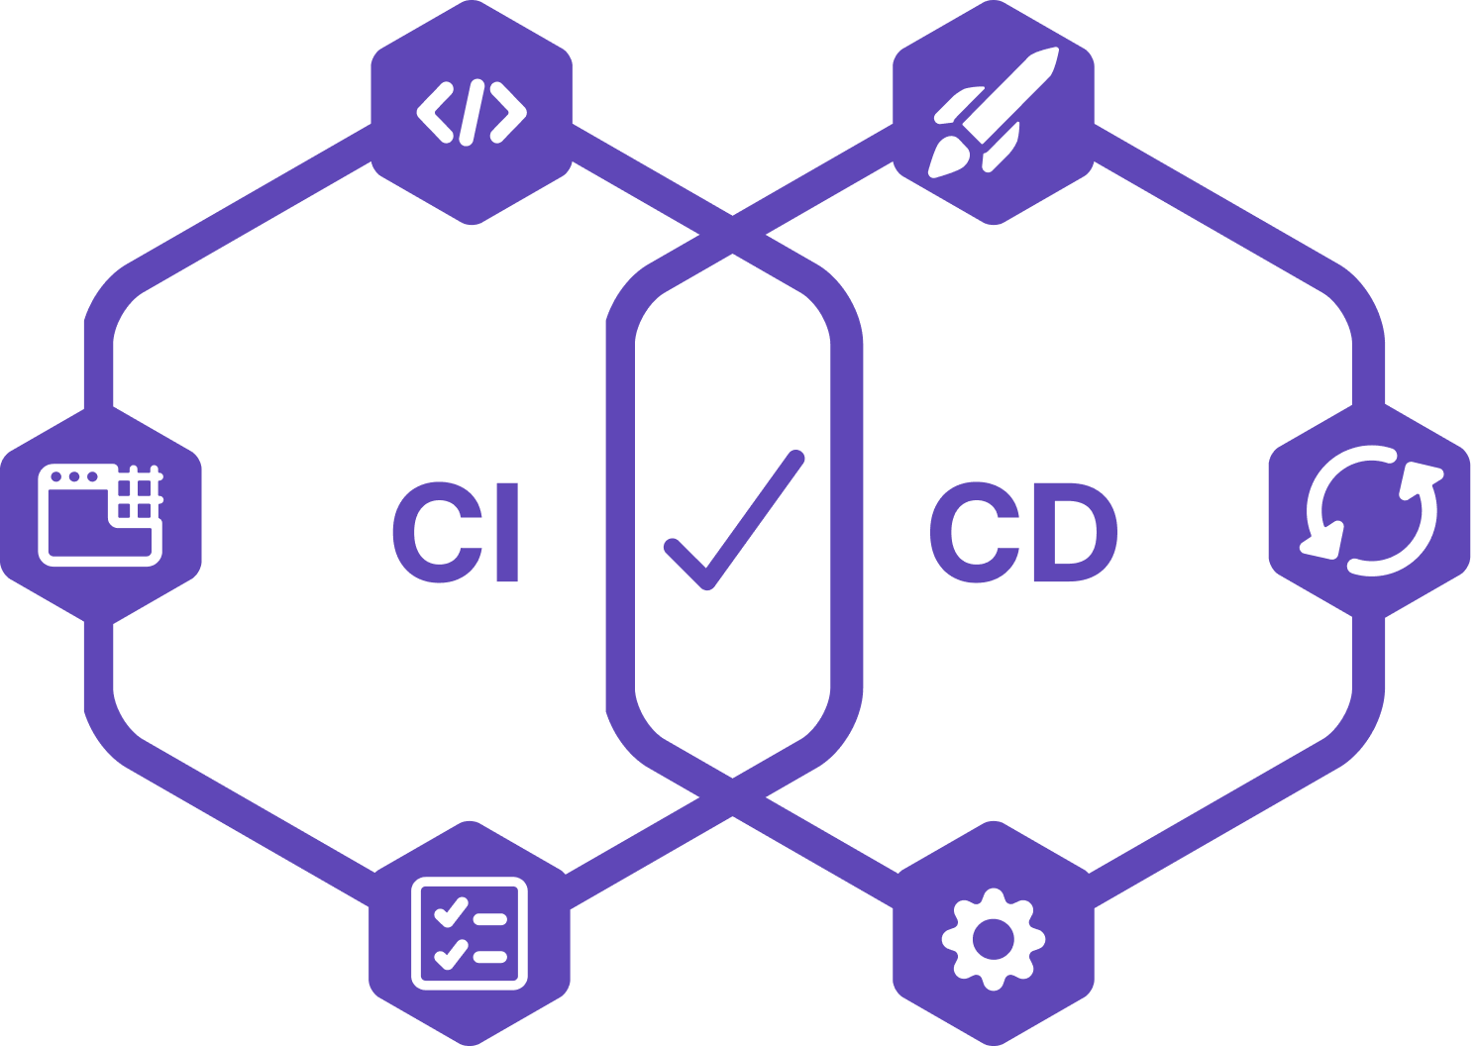
CI / CD Introduction

Slide 4
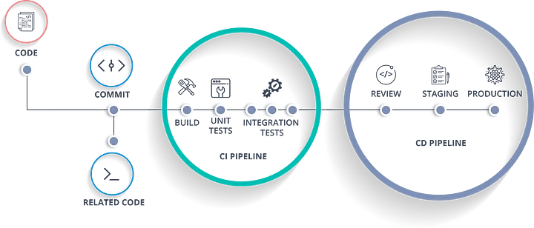
CI/CD, which stands for continuous integration and continuous delivery/deployment, aims to streamline and accelerate the software development lifecycle.
Continuous Integration (CI) refers to the practice of automatically and frequently integrating code changes into a shared source code repository. Continuous Delivery and/or deployment (CD) is a 2 part process that refers to the integration, testing, and delivery of code changes. Continuous delivery stops short of automatic production deployment, while continuous deployment automatically releases the updates into the production environment.
Taken together, these connected practices are often referred to as a CI/CD pipeline and are supported by development and operations teams working together in an agile way with either a DevOps or site reliability engineering (SRE) approach.

Slide 5
Configuration Management
Definition : Configuration Management is a practice of systematically managing and maintaining the configuration of software systems and infrastructure components throughout their lifecycle. It involves processes, tools, and techniques to track, control, and manage configurations.
Purpose: Configuration Management aims to ensure consistency, reliability, and traceability of system configurations. It involves managing software versions, configurations, dependencies, and their relationships. Configuration Management ensures that systems are correctly configured, changes are controlled, and configurations can be reproduced or rolled back.
Scope: Configuration Management covers the management of software configurations, including applications, middleware, databases, and related components. It includes version control, release management, change control, and auditing of configurations.
Tools: Popular Configuration Management tools include Ansible, Puppet, Chef, SaltStack, and Microsoft PowerShell DSC. These tools provide capabilities to define and manage software configurations, enforce desired states, and automate configuration tasks.

Slide 6
Definition:
Cloud computing delivers IT services over the internet, eliminating the need for physical infrastructure.
It provides on-demand resources such as servers, storage, databases, and networking.
Cloud computing enables businesses to scale quickly, reduce costs, and improve efficiency.
Benefits:
Scalability – Easily scale resources up or down based on demand.
Cost Efficiency – Pay only for the resources used, reducing capital expenditure.
High Availability – Ensures uptime and reliability with distributed architecture.
Disaster Recovery – Data backup and recovery solutions for business continuity.

Slide 7
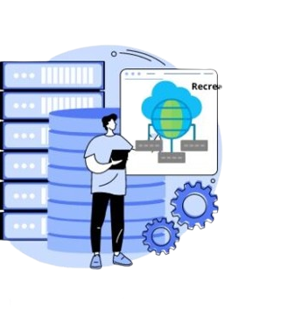
Deployment Strategies

Slide 8
1. Recreate Deployment
How it works: Version A is terminated, then Version B is rolled out.
Example: Shut down app, update, and bring it back online.
Use case: Small apps with acceptable downtime.
2. Ramped (Rolling Update)
How it works: Version B replaces Version A incrementally.
Example: Update one server at a time until all run Version B.
Use case: Large-scale apps with no downtime tolerance.
3. Blue/Green Deployment
How it works: Version B runs alongside Version A; traffic switches instantly.
Example: Switch traffic from Blue (Version A) to Green (Version B).
Use case: Critical apps requiring reliability.

Slide 9
4. Canary Deployment
How it works: Version B is released to a small subset of users first.
Example: Release Version B to 5% of users, then scale to 100%.
Use case: Testing new features with minimal risk.
5. A/B Testing
How it works: Version B is released to a subset under specific conditions.
Example: Test Version B on mobile users in the US.
Use case: Comparing user experience or feature success.
6. Shadow Deployment
How it works: Version B processes real-world traffic without
impacting Version A.
Example: Route live traffic to Version B for testing.
Use case: Testing performance under real-world traffic.

Slide 10
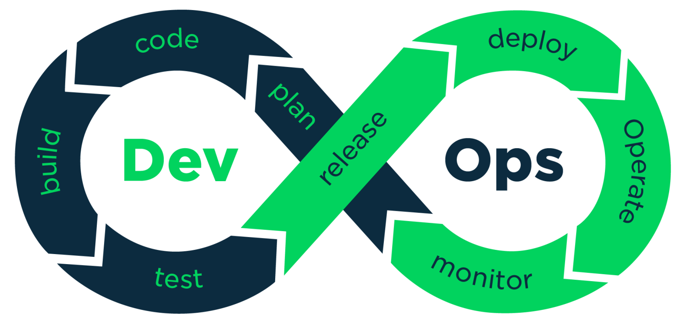

What is DevOps

Slide 11
What is DevOps?
🔹 DevOps is a set of practices that integrates software development (Dev) and IT operations (Ops) to streamline workflows, accelerate software delivery, and ensure high-quality releases through automation and collaboration.
🚀 Key Benefits
✅ Faster & More Reliable Releases – Speeds up development cycles with continuous integration & deployment (CI/CD). ✅ Stronger Team Collaboration – Breaks silos between Dev & Ops, fostering a shared responsibility culture. ✅ Reduced Deployment Risks – Automated testing and monitoring minimize failures. ✅ Higher Efficiency through Automation – Eliminates manual processes, reducing errors & saving time.
🔑 Core Principles (C.A.L.M.S)
1️⃣ Culture – Encourages collaboration, transparency, and shared ownership. 2️⃣ Automation – Speeds up workflows, reduces errors, and enhances scalability. 3️⃣ Lean – Eliminates waste, optimizes workflows, and boosts productivity. 4️⃣ Measurement – Tracks key metrics (performance, deployment frequency, failure rates) for improvement. 5️⃣ Sharing – Promotes knowledge sharing, feedback loops, and continuous learning.

Slide 12
Infra as a Code

Slide 13
Definition:
Managing infrastructure using code instead of manual processes.
Benefits:
- Improves efficiency and reduces human error.
- Enables version control and standardization.
Popular Tools:
- Terraform: Declarative infrastructure provisioning
- CloudFormation: AWS-native infrastructure automation
- Ansible: Configuration management and automation
Use Cases:
- Cloud provisioning, scaling, disaster recovery, multi-cloud deployments

Slide 14
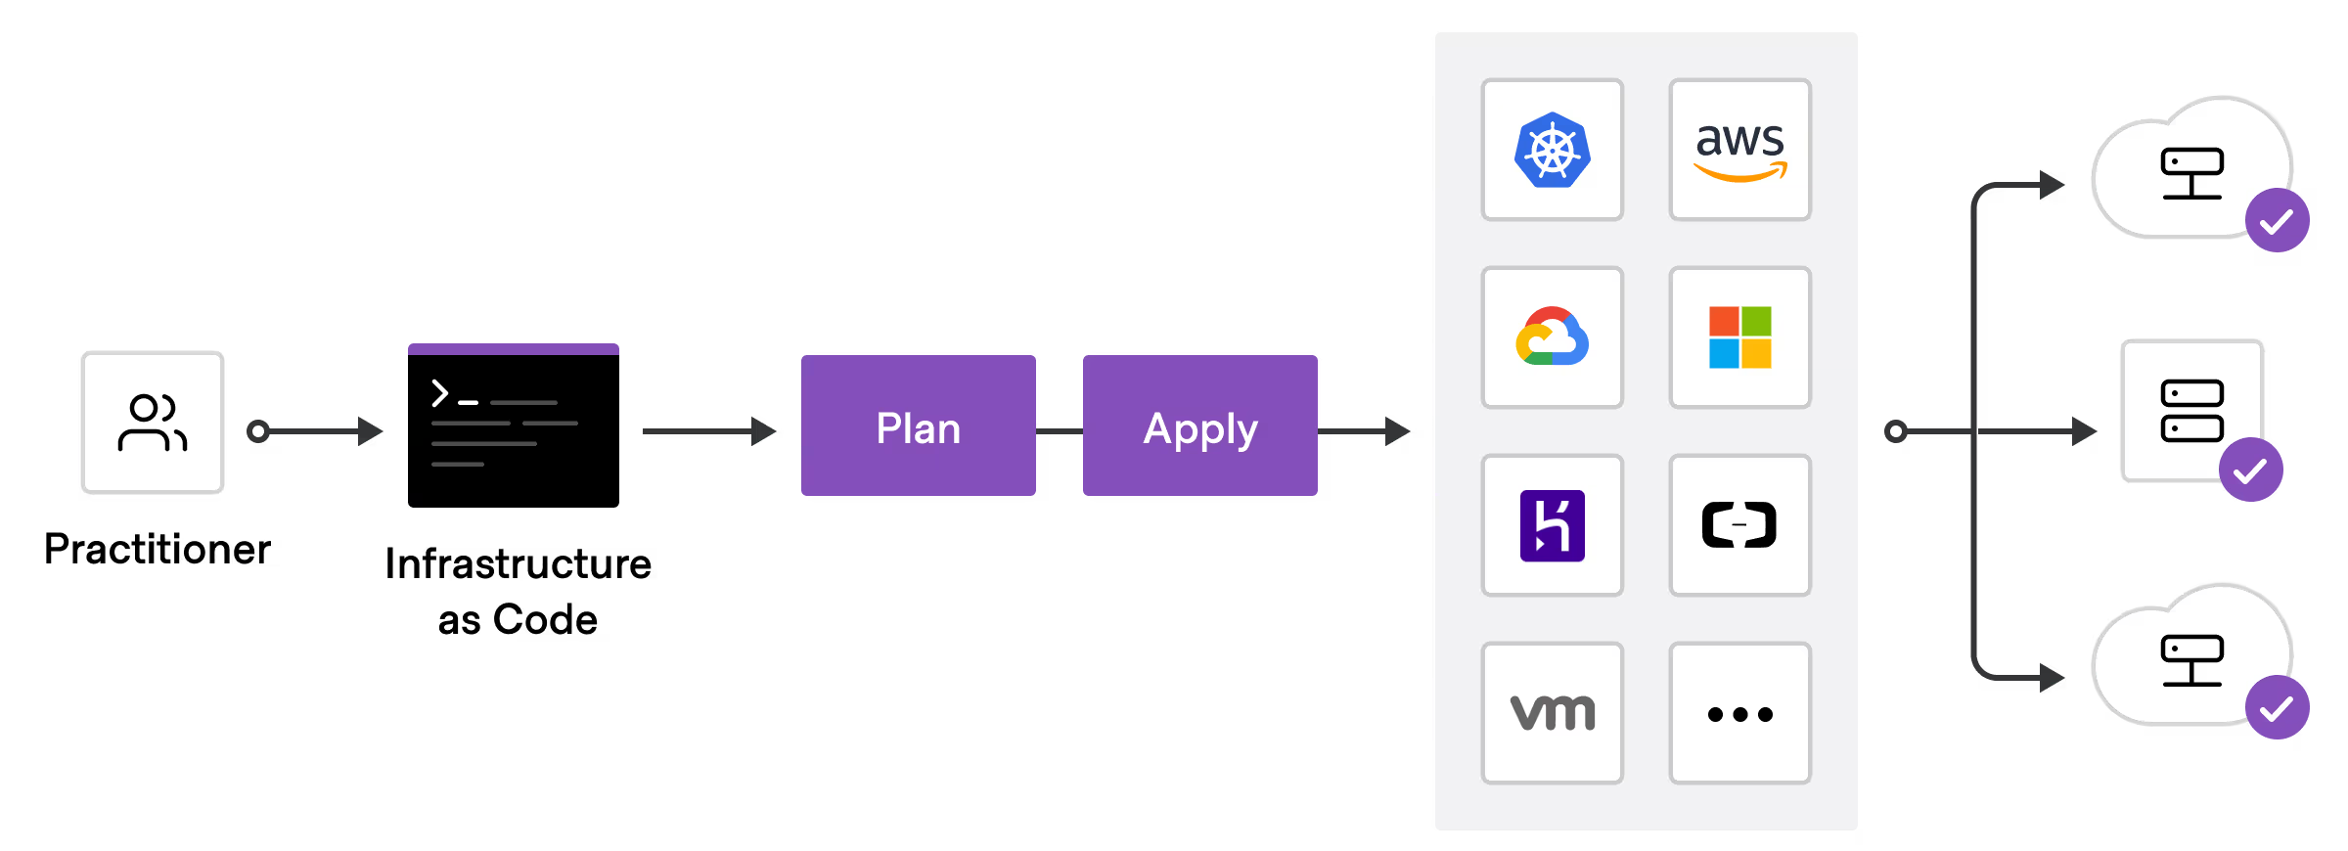



If you use code to provision and configure the infrastructure, it is called Infrastructure as code (IaC). To put it simply, codifying the infrastructure provisioning and configuration.
With the concept of Infrastructure as code, you can follow the same workflow you use for application development for Infrastructure as code development. Meaning, versioning the infrastructure code in git, running unit tests, and integration tests, and then deploying it
Benefits of IaC
Following are some of the key benefits of IaC
With IaC, you can recreate any complex infrastructure with one click.
You can version control your infrastructure state in the form of IaC.
Developer-centric workflow in infrastructure management. Like developing applications, a standard practice for IaaC is to follow all standard coding practices like testing, review, etc. Many companies follow test-driven IAC developed to have fool proof infra-change systems.

Slide 15

Linux

Slide 16
What is Linux?
Linux is a kernel, not a full operating system. It serves as the core component that manages system resources and interacts with hardware.
It was created by Linus Torvalds in 1991 and is open-source under the GNU General Public License (GPL).
Linux is the foundation for complete operating systems called Linux distributions (distros) such as Ubuntu, CentOS, Fedora, and Debian.
It powers most servers, cloud environments, embedded systems, and supercomputers due to its security, stability, and performance.
Why Use Linux?
Security & Stability – Less vulnerable to malware and exploits.
Performance & Efficiency – Optimized for multitasking and high availability.
Customization & Flexibility – Allows full system control and modularity.
Strong Community & Open-Source – Supported by a global community of developers.
Essential for DevOps & Cloud Computing – Most cloud and DevOps tools are built for Linux.

Slide 17
Essential Linux Commands
Basic Navigation & File Management:
ls – Lists directory contents.
cd – Changes directories.
pwd – Displays the current directory.
mkdir – Creates a new directory.
rm – Deletes files or directories.
cp – Copies files and directories.
mv – Moves or renames files.
File Permissions & Ownership:
chmod – Changes file permissions (read, write, execute).
chown – Changes file owner or group.
ls -l – Shows file permissions and ownership details.
Process & System Monitoring:
ps – Displays running processes.
top – Monitors real-time system performance.
kill – Terminates a process by PID.
Searching & Text Processing:
grep – Searches text using patterns.
find – Locates files based on name or type.
awk & sed – Process and modify text files.
Networking & Connectivity:
ping – Tests network connectivity.
curl & wget – Fetches data from URLs.
netstat – Displays network connections and statistics.
Package Management:
Debian-based (Ubuntu): apt-get install <package_name>
Red Hat-based: yum install <package_name>

Slide 18
Thank you
Brita Tamm
502-555-0152
brita@firstupconsultants.com
www.firstupconsultants.com

